Slide 1
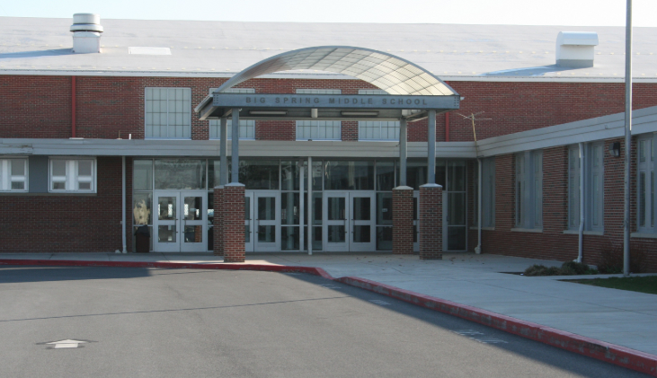
Student Supports at
Big Spring MS
Spring 2019

Slide 2
Key Supports
Teacher
Counselor
Principal or Assistant Principal
Parents

Slide 3
How do we support each other and keep ourselves safe?

Slide 4
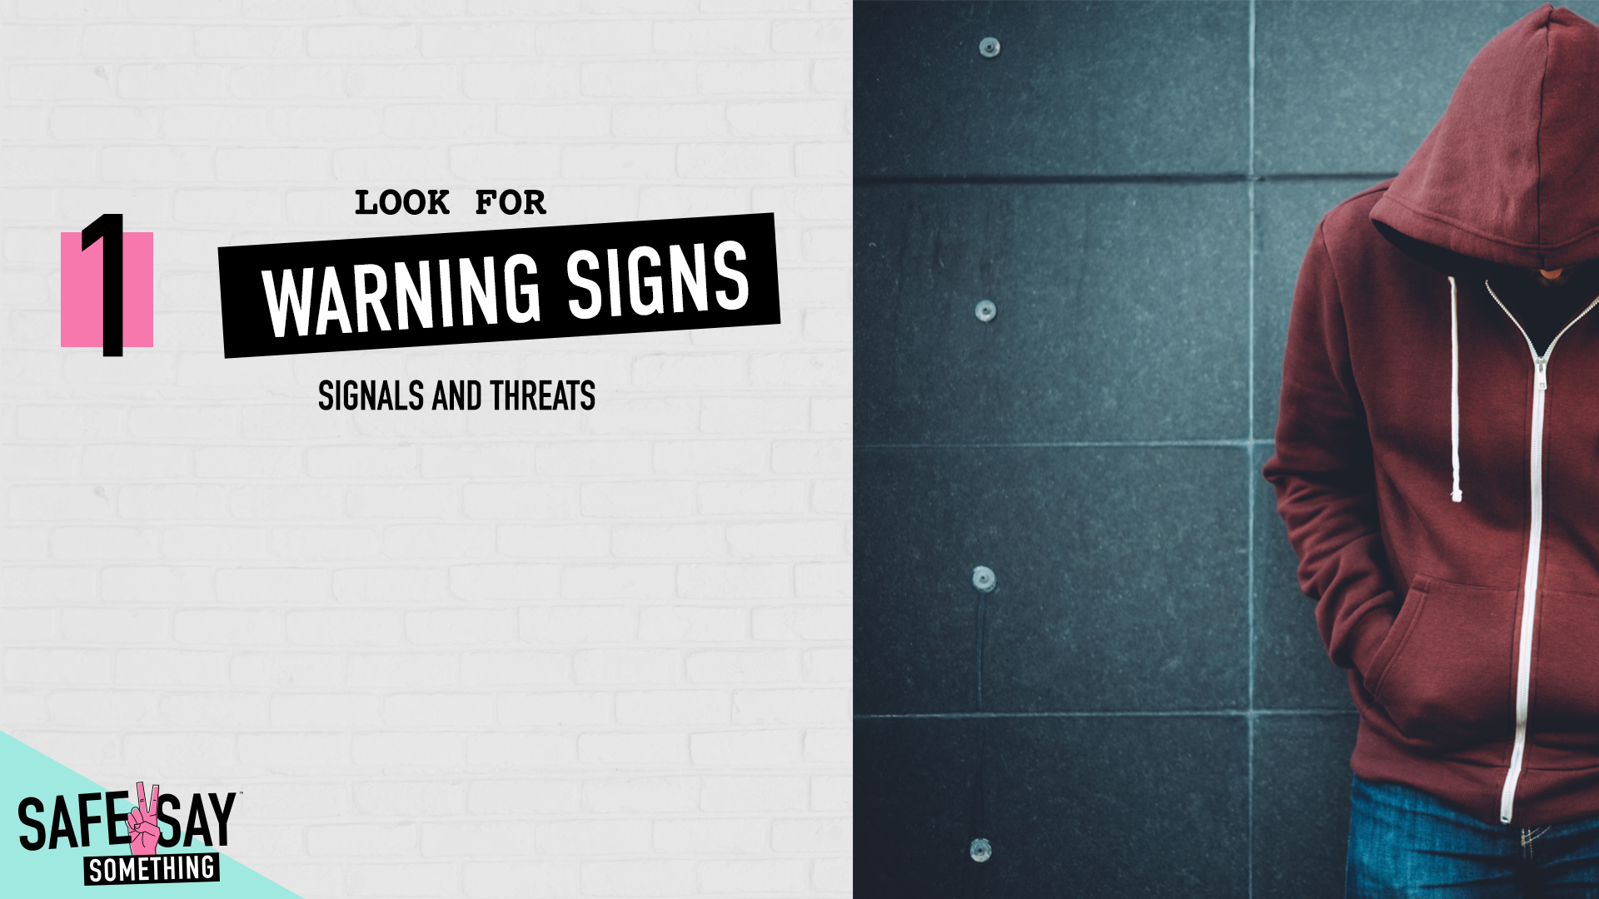

Slide 5
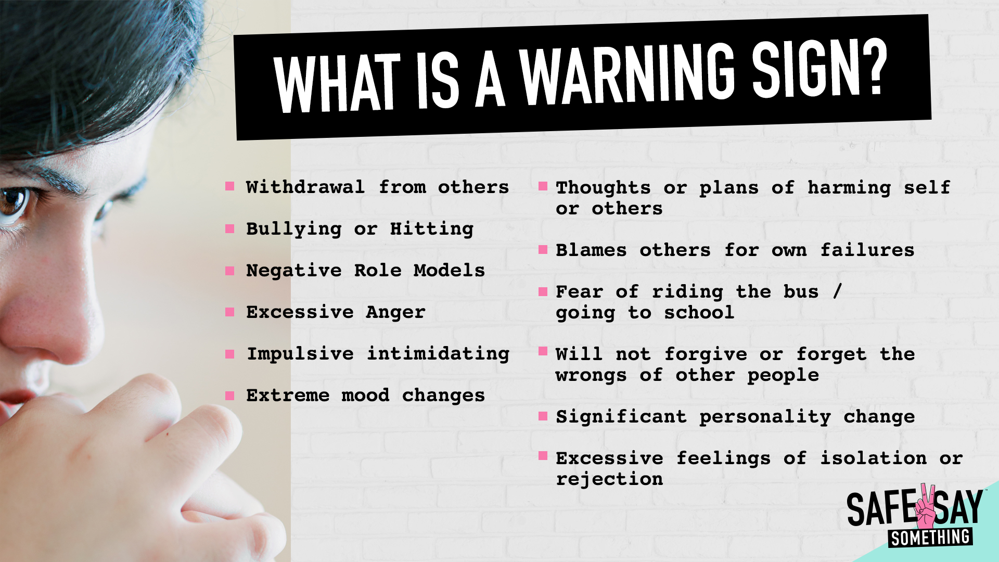

Slide 6

Any communication directly
or through a third party which
has the intent to HARM
themselves or someone

Slide 7

SPOKEN
PHOTOS
VIDEOS
WRITTEN
GESTURES
ACTIONS &
BEHAVIORS

Slide 8
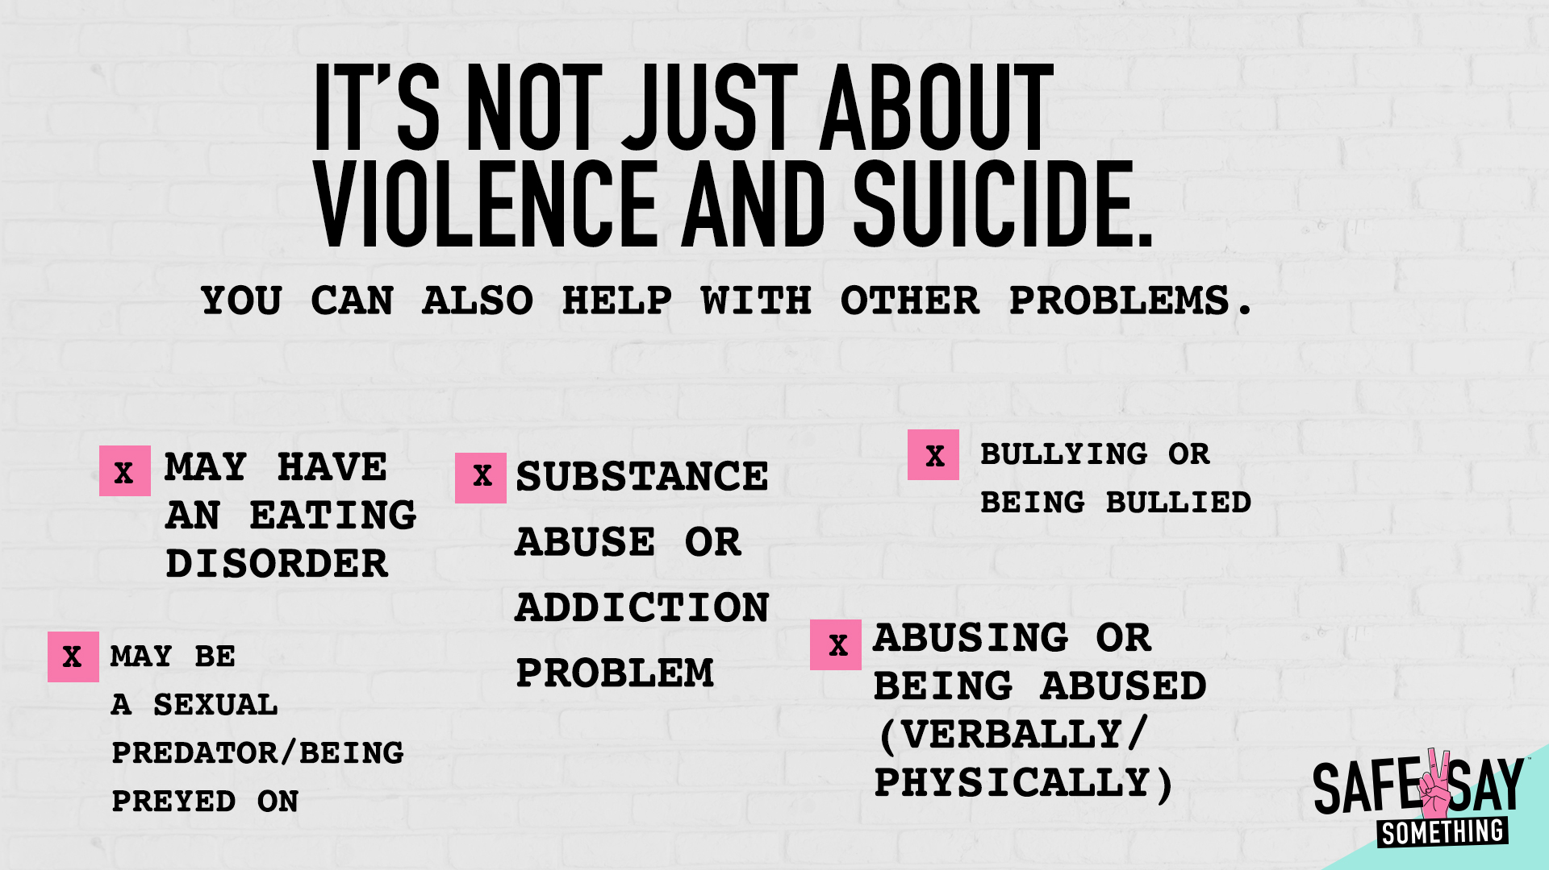

Slide 9
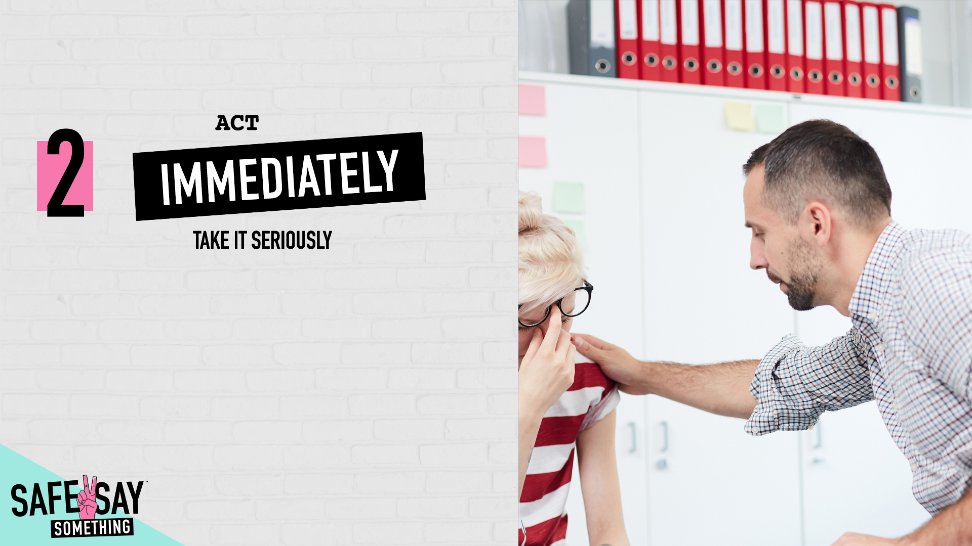

Slide 10
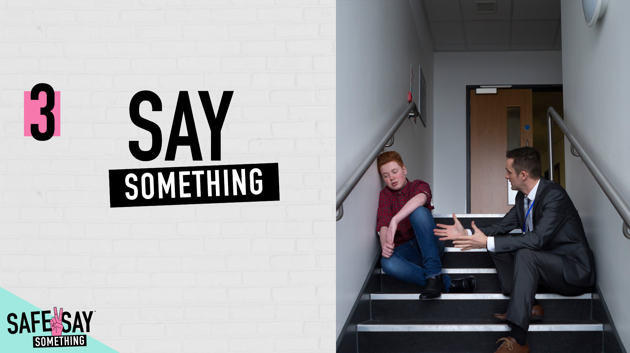

Slide 11
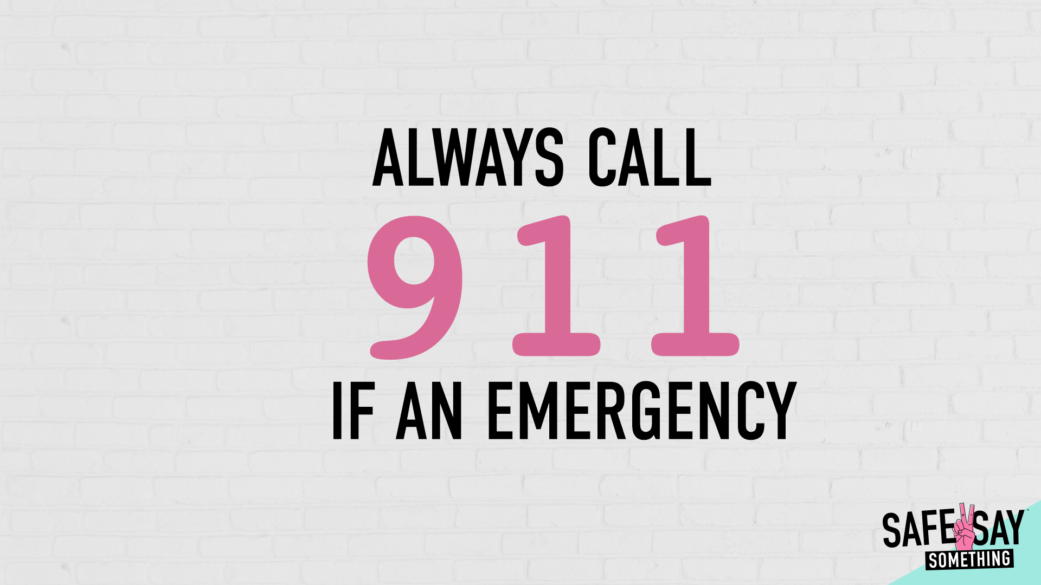

Slide 12
Seek a Trusted Adult

Slide 13
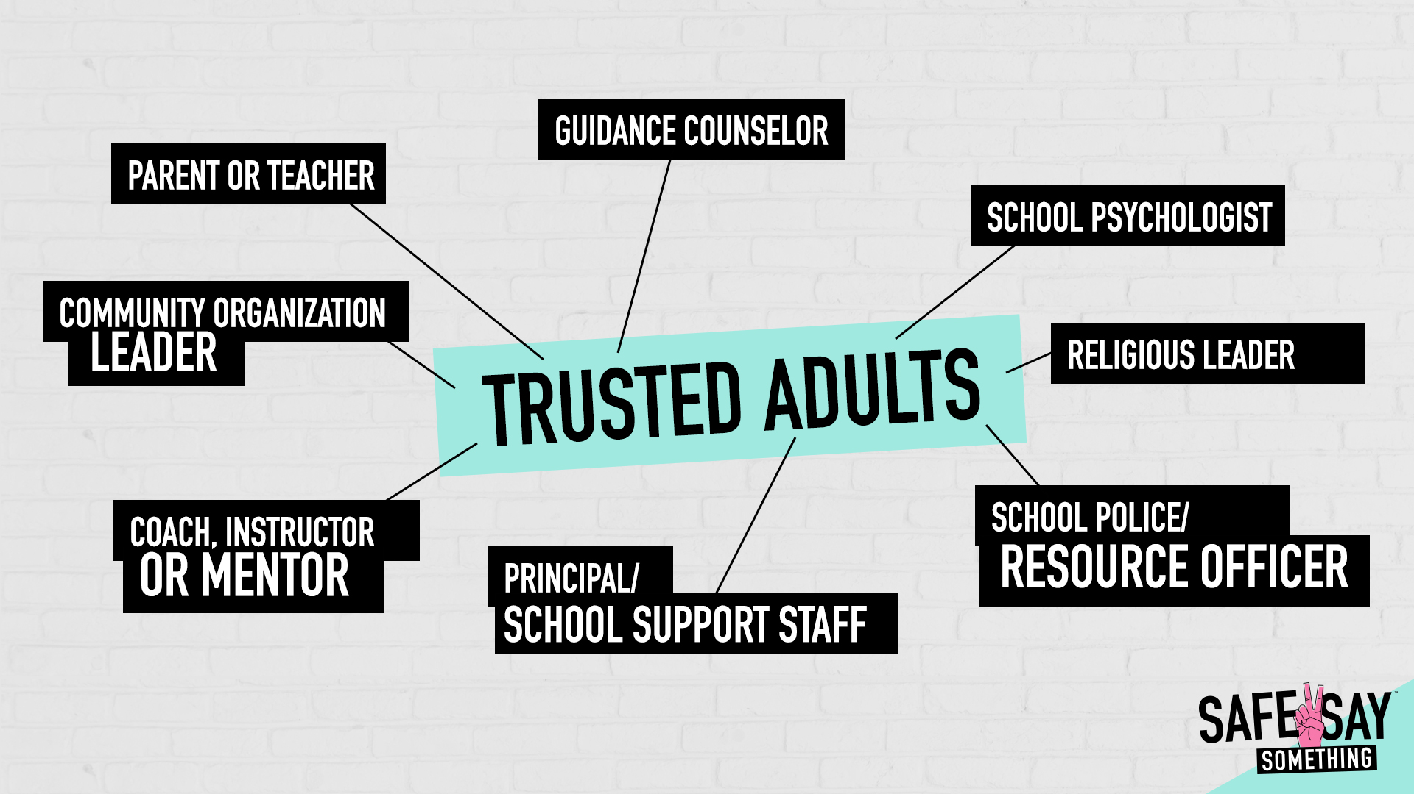

Slide 14
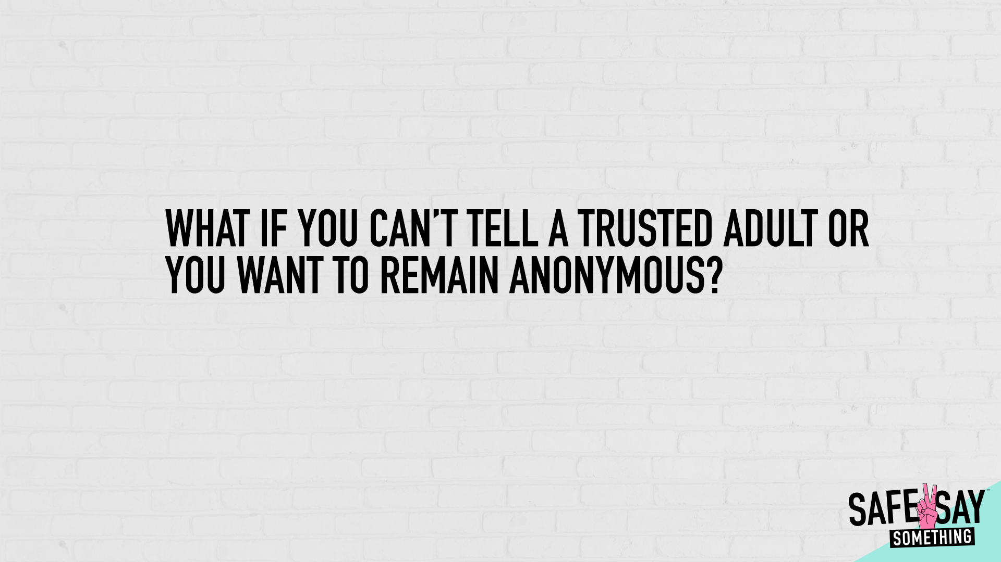

Slide 15
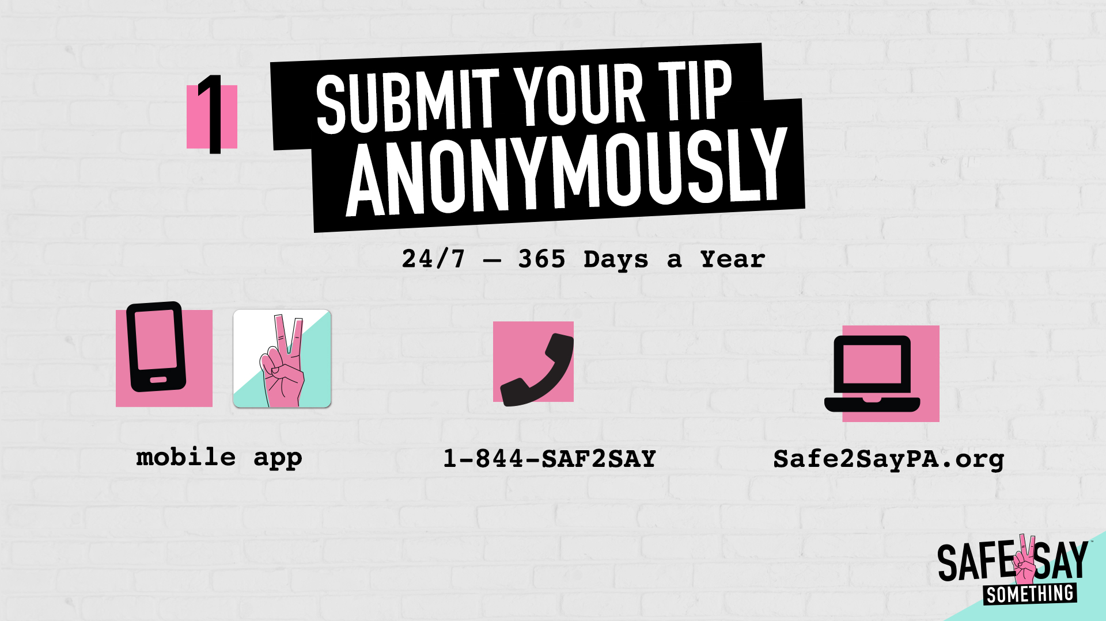
LOOK FOR POSTERS WITH THIS LOGO
AROUND OUR SCHOOL FOR MORE INFORMATION

Slide 16

Again, if you need support or are concerned for someone else…

